Slide 1
Algoritma & Pemrograman
Fundamentals
Prepared by
Frans Panduwinata, S.Kom, M.T

Slide 2
Algorithm
A formula or set of steps for solving a particular problem.
To be an algorithm, a set of rules must be unambiguous and have a clear stopping point.
Algorithms can be expressed in any language, from natural languages like English.

Slide 3
Algorithm (cont)
We use algorithms every day. For example, a recipe for baking a cake is an algorithm.
Most programs, with the exception of some artificial intelligence applications, consist of algorithms.
Inventing elegant algorithms -- algorithms that are simple and require the fewest steps possible -- is one of the principal challenges in programming.

Slide 4
Pseudocode
An outline of a program, written in a form that can easily be converted into real programming statements.
For EXAMPLE, Computing a Quiz Average
get number of quizzes
sum = 0
count = 0
while count < number of quizzes
get quiz grade
sum = sum + quiz grade
count = count + 1
average = sum / number of quizzes
display average
halt

Slide 5
Pseudocode (cont)
Pseudocode CANNOT be compiled nor executed, and there are no real formatting or syntax rules.
It is simply one step - an important one - in producing the final code.
The benefit of pseudocode is that it enables the programmer to concentrate on the algorithms without worrying about all the syntactic details of a particular programming language.
In fact, you can write pseudocode without even knowing what programming language you will use for the final implementation.

Slide 6
Flow Chart
A flow chart is a graphical or symbolic representation of a process.
Each step in the process is represented by a different symbol and contains a short description of the process step.
The flow chart symbols are linked together with arrows showing the process flow direction.

Slide 7
Common Flow Chart Symbols
Terminator
An oval flow chart shape indicating the start or end of the process.
Process
A rectangular flow chart shape indicating a normal process flow step.
Decision
A diamond flow chart shape indication a branch in the process flow.

Slide 8
Common Flow Chart Symbols (cont)
Connector
A small, labeled, circular flow chart shape used to indicate a jump in the process flow. (Shown as the circle with the letter “A”, below.)
Data
A parallelogram that indicates data input or output (I/O) for a process.
Document
Used to indicate a document or report.

Slide 9
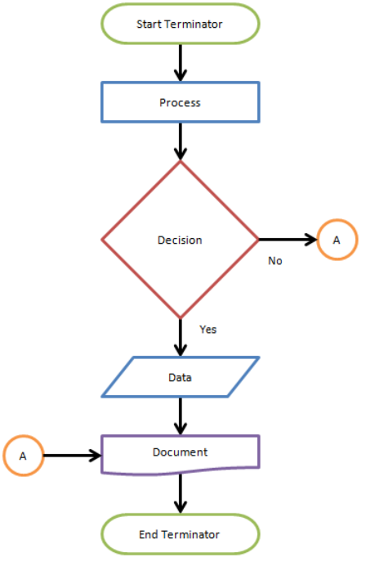
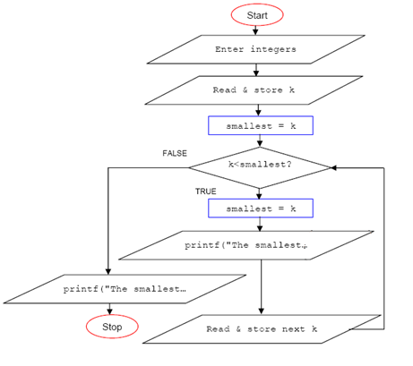
Common Flow Chart Symbols (cont)
Example:

Slide 10
Characteristics of C++
C++ is NOT a purely object-oriented language but a hybrid that contains the functionality of the C programming language.
This means that you have all the features that are available in C:
  Universally usable modular programs
  Efficient, close to the machine programming
  Portable programs for various platforms.
Various language elements were added to C++ for efficient program implementation, such as References, Templates, and Exception Handling.

Slide 11
Traditional Procedural Programming
Data and Functions (subroutines, procedures) are kept separate from the data they process.
This has a significant effect on the way a program handles data:
  Ensure that data are INITIALIZED with suitable values before use and that suitable data are passed to a function when it is called.
  If the data representation is CHANGED,
  e.g. if a record is extended, the corresponding functions must also be modified.

Slide 12
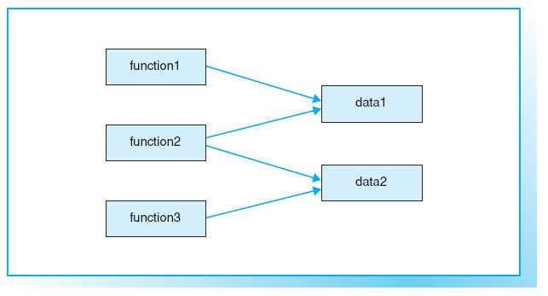
Traditional Concept

Slide 13
Objects
OOP shifts the focus of attention to the Objects, that is, to the aspects on which the problem is centered.
A program designed to maintain bank accounts would work with data such as balances, credit limits, transfers, interest calculations, and so on.
For EXAMPLE:
An object representing an account in a program will have properties and capacities that are important for account management.

Slide 14
Objects (cont)
OOP objects combine
Data (properties) and Functions (capacities).
A CLASS defines
a certain object type by defining both the properties and the capacities of the objects of that type.
Objects Communicate by
sending each other “messages,” which in turn activate another object’s capacities.

Slide 15
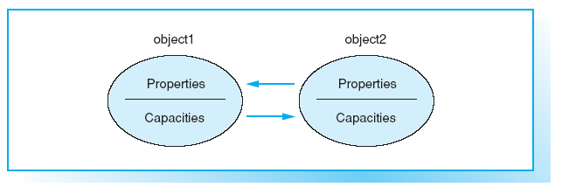
Object-oriented Concept

Slide 16
Advantages of OOP
Reduced susceptibility to errors:
an object controls access to its own data. More specifically, an object can reject erroneous access attempts
Easy re-use:
objects maintain themselves and can therefore be used as building blocks for other programs
Low maintenance requirement:
an object type can modify its own internal data representation without requiring changes to the application.

Slide 17
Translating a C++ Program
The following three steps are required to create and translate a C++ program:
  A text editor is used to save the C++ program in a text file.
    The source code is saved to a source file.
    In larger projects the programmer will normally use modular programming, the source code will be stored in several source files that are edited and translated separately.
  The source file is put through a compiler for translation.
    If everything works as planned, an object file made up of machine code is created. The object file is also referred to as a module.

Slide 18
Translating a C++ Program (cont)
  The linker combines the object file with other modules to form an executable file.
    These further modules contain functions from standard libraries or parts of the program that have been compiled previously.

Slide 19
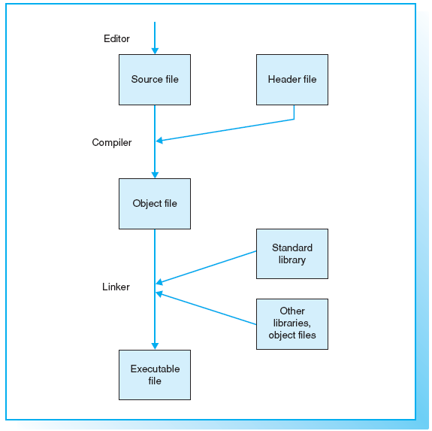
Translating a C++ Program (cont)

Slide 20
Translating a C++ Program (cont)
The most commonly found file extensions are .CPP and .CC.
Prior to compilation, header files, which are also referred to as include files, can be copied to the source file.
Header files are text files containing information needed by various source files, for example, type definitions or declarations of variables and functions.
Header files can have the file extension .H.

Slide 21
Translating a C++ Program (cont)
The C++ standard library contains predefined and standardized functions that are available for any compiler.
Modern compilers normally offer an Integrated software development environment, which combines the steps mentioned previously into a single task.
A graphical user interface is available for editing, compiling, linking, and running the application.

Slide 22
Translating a C++ Program (cont)
In addition to error messages, the compiler will also issue warnings.
  A warning does not indicate a syntax error but merely draws your attention to a possible error in the program’s logic, such as the use of a non-initialized variable.

Slide 23
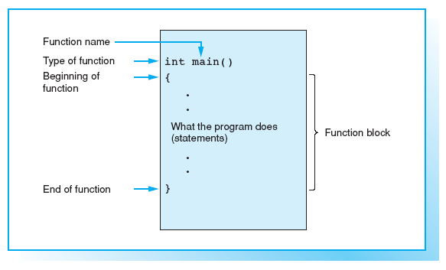
Structure of Function main()

Slide 24
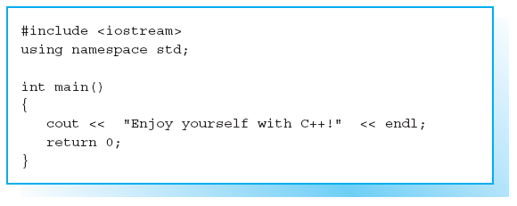

Sample Program

Slide 25
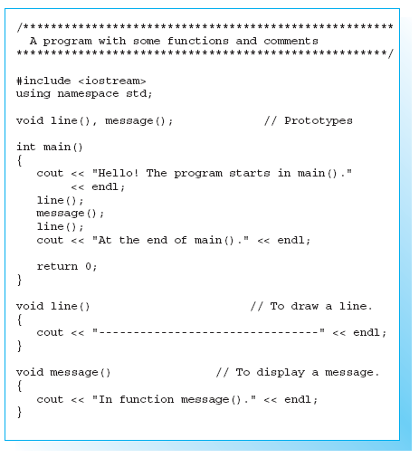
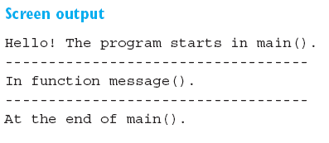
A C++ Program with Several Functions

Slide 26
Exercises
EXERCISE 1
Write a C++ program that outputs the following text on
screen:
Oh what
a happy day!
Oh yes,
what a happy day!
NOTE: Use the manipulator endl where appropriate.

Slide 27
Exercises (cont)
EXERCISE 2
The following program contains several errors:
*/ Now you should not forget your glasses //
#include <stream>
int main
{
cout << "If this text",
cout >> " appears on your display, ";
cout << " endl;"
cout << 'you can pat yourself on '<< " the back!" << endl.
return 0;
)
Resolve the errors and run the program to test your changes.

Slide 28
Data Type Overview
A program can use several data to solve a given problem, for example, characters, integers, or floating-point numbers.
Since a computer uses different methods for processing and saving data, the data type must be known. The type defines
    The internal representation of the data, and
    The amount of memory to allocate.
A number such as -1000 can be stored in either 2 or 4 bytes.

Slide 29
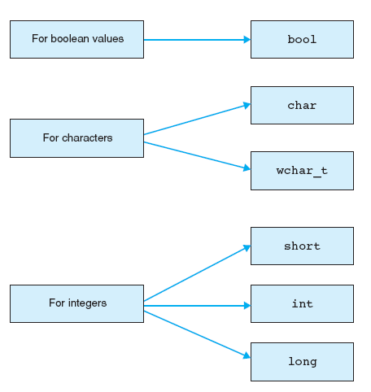
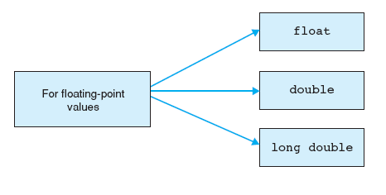
Data Type Overview (cont)

Slide 30
The Type bool
The result of a comparison or a logical association using AND or OR is a boolean value, which can be TRUE or FALSE.
C++ uses the bool type to represent boolean values.
An expression of the type bool can either be true or false,
  TRUE will be represented as the numerical value 1 and
  FALSE by a ZERO.

Slide 31
The char and wchar_t Types
These types are used for saving character codes.
A character code is an integer associated with each character.
For EXAMPLE:
The letter A is represented by code 65, for example.

Slide 32
The char and wchar_t Types (cont)
The C++ language does not stipulate any particular characters set, although in general a character set that contains the ASCII code (American Standard Code for Information Interchange) is used.
This 7-bit code contains
  definitions for 32 control characters (codes 0 – 31) and
  96 printable characters (codes 32 – 127).

Slide 33
The char and wchar_t Types (cont)
The char (character) type is used to store character codes in one byte (8 bits).
This amount of storage is sufficient for extended character sets,
For EXAMPLE:
The ANSI character set that contains the ASCII codes and additional characters such as German umlauts.

Slide 34
The char and wchar_t Types (cont)
The wchar_t (wide character type) type comprises at least 2 bytes (16 bits) and is thus capable of storing modern Unicode characters.
Unicode is a 16-bit code also used in Windows NT and containing codes for approximately 35,000 characters in 24 languages.

Slide 35
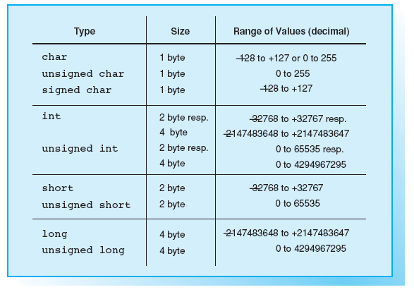
Integral Types
The types short, int,
and long are available
for operations with
integers.
These types are
distinguished by their
ranges of values.

Slide 36
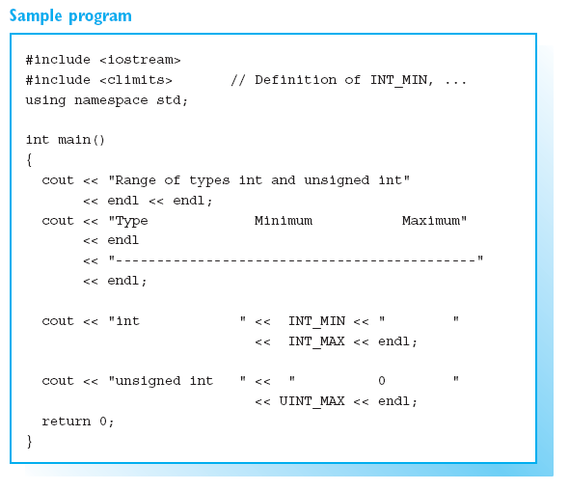
Integral Types (cont)
The climits header file
defines constants such as
CHAR_MIN, CHAR_MAX,
INT_MIN, and INT_MAX,
which represent the smallest
and greatest possible values.

Slide 37
Floating-point Types
In contrast to integers, floating-point numbers must be stored to a preset accuracy.
The following three types are available for calculations involving floating-point numbers:
  float for simple accuracy
  double for double accuracy
  long double for high accuracy
Accuracy is expressed in decimal places.

Slide 38
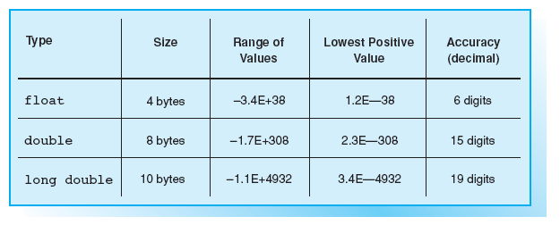
Floating-point Types (cont)

Slide 39
Classification
The fundamental types in C++ are integer types, floating-point types, and the void type.
The types used for integers and floating-point numbers are collectively referred to as arithmetic types, as arithmetic operators are defined for them.
The void type is used for expressions that do not represent a value. A function call can thus take a void type.

Slide 40
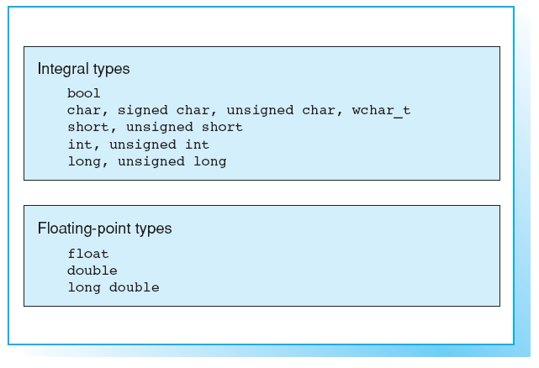
Arithmetic Types

Slide 41
The sizeof Operator
The amount of memory needed to store an object of a certain type can be ascertained using the sizeof operator:
sizeof(name)
For EXAMPLE,
sizeof(int) represents a value of 2 or 4 depending on the machine. In contrast, sizeof(float) will always equal 4.

Slide 42
Constants Types
Constants can be subdivided into:
  boolean constants
  numerical constants
  character constants
  string constants.

Slide 43
Constants Types (cont)
Boolean Constants
  A boolean expression can have two values that are identified by the
  keywords true and false.
  Both constants are of the bool type.
  For example, to set flags representing just two states.

Slide 44
Constants Types (cont)
Integral Constants
Integral numerical constants can be represented as simple decimal numbers, octals, or hexadecimals :
  a decimal constant (base 10) begins with a decimal number other than
  zero, such as 109 or 987650
  an octal constant (base 8) begins with a leading 0, for example 077 or
  01234567
  a hexadecimal constant (base 16) begins with the character pair 0x or 0X,
  for example 0x2A0 or 0X4b1C. Hexadecimal numbers can be capitalized
  or noncapitalized.

Slide 45
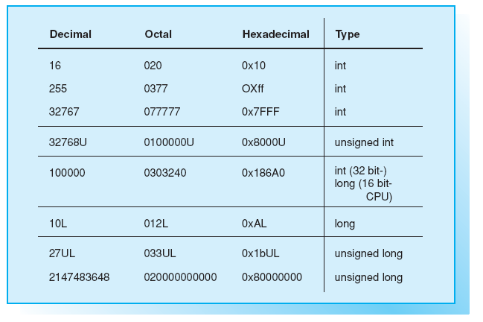
Integral Constants

Slide 46
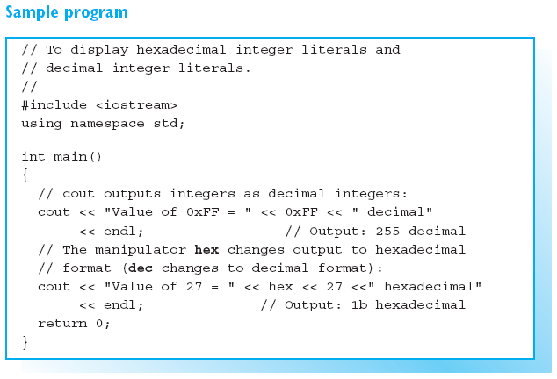
Integral Constants (cont)

Slide 47
Floating-point Constants
EXAMPLES:
27.1 1.8E–2 // Type: double
1.8E–2 represents a value of 1.8*10–2.
E can also be written with a small letter e.
A decimal point or E (e) must always be used to distinguish floating-point constants from integer constants.

Slide 48
Floating-point Constants (cont)
Floating-point constants are of type double by default.
However, you can add F or f to designate the float type, or add L or l for the long double type.

Slide 49
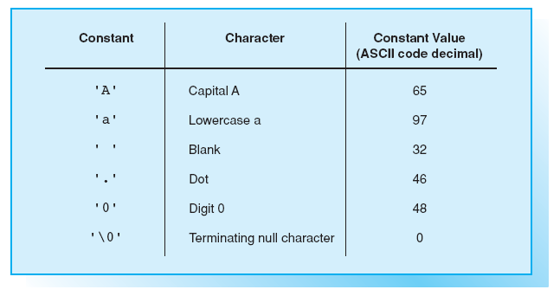
Character Constants
A character constant
is a character
enclosed in single
quotes.
EXAMPLE:
'A' // Type: char
The numerical value is the character code representing the character.
The constant 'A‘ thus has a value of 65 in ASCII code.

Slide 50
String Constants
A string constant consists of a sequence of characters enclosed in double quotes.
EXAMPLE:
"Today is a beautiful day!"
A string constant is stored internally without the quotes but terminated with a NULL character, \0, represented by a byte with a numerical value of 0.
Thus, a string occupies one byte more in memory than the number of characters it contains.

Slide 51
String Constants (cont)
An empty string, "", therefore occupies a single byte.
The terminating null character \0 is not the same as the number zero and has a different character code than zero.
EXAMPLE:
"0"
comprises two bytes, the first byte containing the code for the character zero 0 (ASCII code 48) and the second byte the value 0.
The terminating null character \0 is an example of an escape sequence

Slide 52
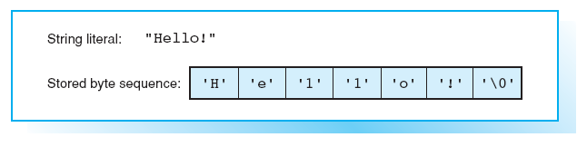
Internal Representation of A String Literal

Slide 53
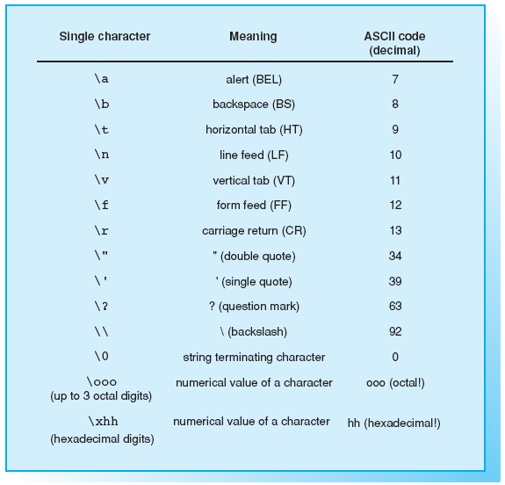
Escape Sequences

Slide 54
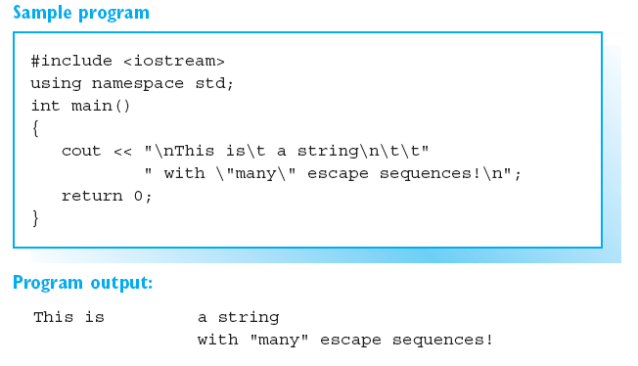
Escape Sequences (cont)

Slide 55
Valid Names
Within a program names are used to designate variables and functions.
The following rules apply when creating names, which are also known as identifiers:
  A name contains a series of letters, numbers, or underscore characters (_).
  German umlauts and accented letters are invalid.
  C++ is case sensitive.
  The first character must be a letter or underscore.
  There are no restrictions on the length of a name and all the characters in
  the name are significant.
  C++ keywords are reserved and cannot be used as names.

Slide 56
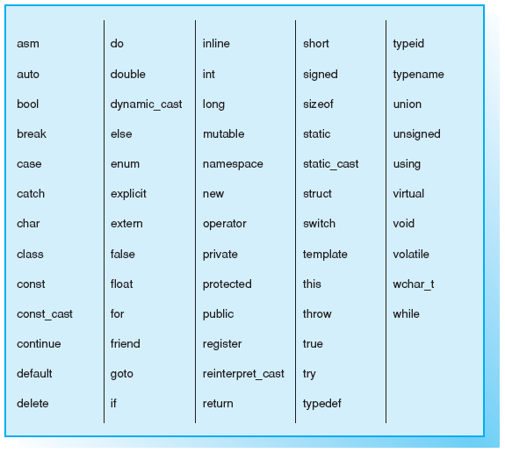
Keywords in C++

Slide 57
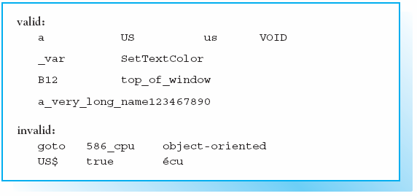
Examples for Names

Slide 58
Conventions
In C++ it is standard practice to use small letters for the names of variables and functions.
The names of some variables tend to be associated with a specific use.
EXAMPLES:
    c, ch for characters
    i, j, k, l, m, n for integers, in particular indices
    x, y, z for floating-point numbers

Slide 59
Conventions (cont)
To improve the readability of your programs you should choose longer and more selfexplanatory names, such as start_index or startIndex for the first index in a range of index values.

Slide 60
Defining Variables
A variable must be defined before you can use it in a program.
SYNTAX:
typ name1 [name2 ... ];
EXAMPLES:
char c;
int i, counter;
double x, y, size;

Slide 61
Defining Variables (cont)
In a program, variables can be defined either within the program’s functions or outside of them. This has the following effect:
  a variable defined outside of each function is global,
  i.e. it can be used by all functions.
  a variable defined Within a function is local,
  i.e. it can be used only in that function.
NOTES:
Local variables can be defined wherever a statement is permitted. This means that variables can be defined immediately before they are used by the program.

Slide 62
Initialization
A variable can be initialized,
i.e. a value can be assigned to the variable, during its definition.
Initialization is achieved by placing the following immediately after the name of the variable:
  an equals sign ( = ) and an initial value for the variable or
  round brackets containing the value of the variable.
EXAMPLES:
      char c = 'a';
      float x(1.875);

Slide 63
Initialization (cont)
Any global variables not explicitly initialized default to zero.
In contrast, the initial value for any local variables that you fail to initialize will have an undefined initial value.

Slide 64
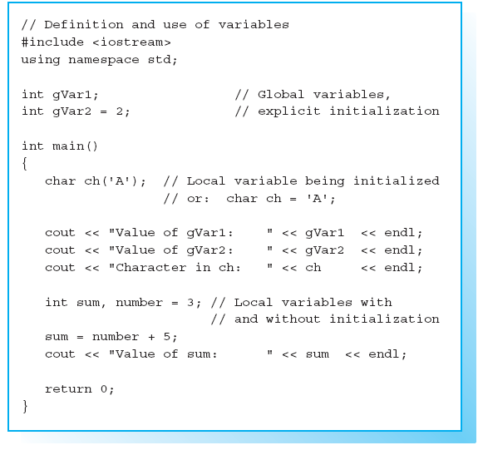
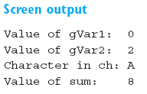
Sample Program

Slide 65
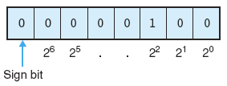
Binary Number Representation
The binary representation of the number 4 as signed char type value (8 bits) is thus as follows:

Slide 66
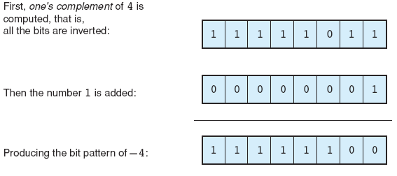
Binary Number Representation (cont)
Two’s complement is used to represent a negative number, for example -4:

Slide 67
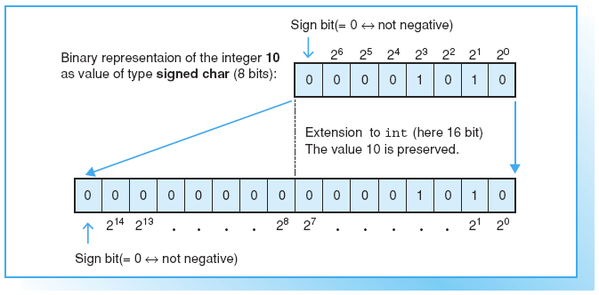
Converting Signed Integers
Converting a positive number

Slide 68
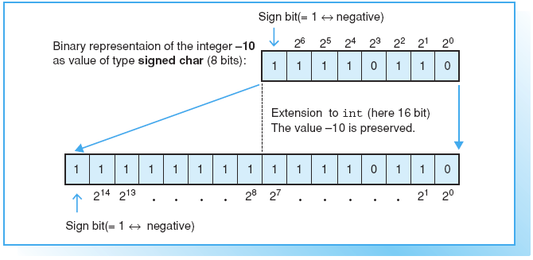
Converting Signed Integers (cont)
Converting a negative number
The bit pattern of –10 is computed by starting with the bit pattern of 10 and generating the binary complement.

Slide 69
Converting Signed Integers (cont)
Converting a negative number (cont)
  The value of a negative number changes if the bit pattern is interpreted as unsigned.
  The bit pattern 1111 0110 of –10, for example, corresponds to the unsigned char value
246 = 0*2⁰ + 1*2¹ + 1*2² + 0*2³ + 1*2⁴ + 1*2⁵ + 1*2⁶ + 1*2⁷

Slide 70
Explicit Type Conversion
cast operator (type) is used to convert the type of an expression explicitly.
SYNTAX:
(type) expression
  This converts the value of an expression to the given type.
  Explicit type conversion is also known as casting.

Slide 71
Explicit Type Conversion (cont)
The cast operator (type) is a unary operator and thus has a higher precedence than the arithmetic operators.
EXAMPLE:
int a = 1, b = 4;
double x;
x = (double)a/b;
  The value of a is explicitly converted to a double.
  Following the conventions of usual implicit type conversion, b is also converted to double and a floating point division is performed.
  The exact result, 0.25, is assigned to the variable x.
  WITHOUT casting, an integer division with a result of 0 would have occurred.

Slide 72
Constant Objects
The const keyword is used to create a “read only” object.
As an object of this type is constant, it cannot be modified at a later stage and must be initialized during its definition.
EXAMPLE:
const double pi = 3.1415947;
Thus the value of pi cannot be modified by the program.
Even a statement such as the following will merely result in an error message:
pi = pi + 2.0; // invalid

Slide 73
Volatile Objects
The keyword volatile, which is rarely used, creates variables that can be modified not only by the program but also by other programs and external events.
Events can be initiated by interrupts or by a hardware clock.
EXAMPLE:
volatile unsigned long clock_ticks;

Slide 74
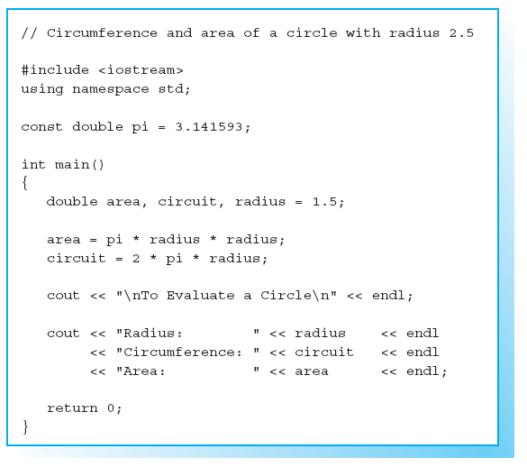
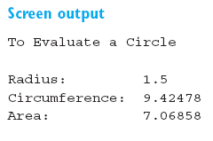
Sample Program

Slide 75
Exercises
EXERCISE 1
Which of the variable definitions shown below is invalid or
does not make sense?
int a(2.5);
int b = '?';
char z(500);
int big = 40000;
double he's(1.2E+5);
const long large;
char c('\'');
unsigned char ch = '\201';
unsigned size(40000);
float val = 12345.12345;

Slide 76
Exercises (cont)
EXERCISE 2
Write a C++ program that two defines variables for floating-
point numbers and initializes them with the values
123.456 and 76.543
Then display the sum and the difference of these two
numbers on screen.

Slide 77
Exercises (cont)
EXERCISE 3
How often is the following loop executed?
unsigned int limit = 1000;
for (int i = –1; i < limit; i++)
// . . .

